Slide 1




State of Chrome Dev Tools, 2017
Dave Brock LTUG @ The Great Dane December 14, 2017

Slide 2
AGENDA
CONTRIBUTE TO LTUG!
WHAT’S NEW?
WHICH VERSION OF CHROME AM I ON?
USING NEW FEATURES
DEMO
RESOURCES

Slide 3
Contribute to ltug!
All topics welcome!
A great way to get your feet wet speaking in front of a low-stress environment
Master a topic!
Check out the LTUG Topics list for an upcoming schedule of topics
Let Matt Frye/Dave Brock know how they can help you deliver a talk – we are looking for topics for February!

Slide 4
WHAT’S NEW since we LAST TALKED?
Chrome 58 - cookie values now editable, pauses before out-of-memory errors
Chrome 59 - CSS/JS code coverage, full page screenshots
Chrome 60 – new Audits panel, Continue to Here, network throttling
Chrome 61 – storage usage, mobile throttling
Chrome 62 – viewport screenshots, console API
Chrome 63 – workspaces, audits, push notifications
Chrome 64 – live performance monitor, console sidebar

Slide 5
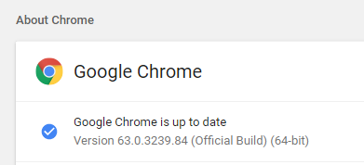
WHICH VERSION OF CHROME AM I ON?
To find out the version of Chrome you are using, navigate to chrome://settings/help (or Help -> About Google Chrome will take you there)

Slide 6

Using the new features that aren’t pushed to chrome yet
In normal Chrome (‘Chrome Stable’), enable Experiments from Settings (hit Shift six times to get the full list)
Preferred approach: Download Chrome Canary (‘Chrome Unstable’) to help distinguish what is new and might break vs. what is in the regular Chrome release

Slide 7

DEMO TIME

Slide 8
RESOURCES
Chrome DevTools documentation
Social media
@ChromeDevTools (Twitter)
Chrome Developers YouTube channel (provides a lot of good DevTools information)

